Slide 1
Java 4 WEB
Lesson 6 – Home tasks overview

Slide 2
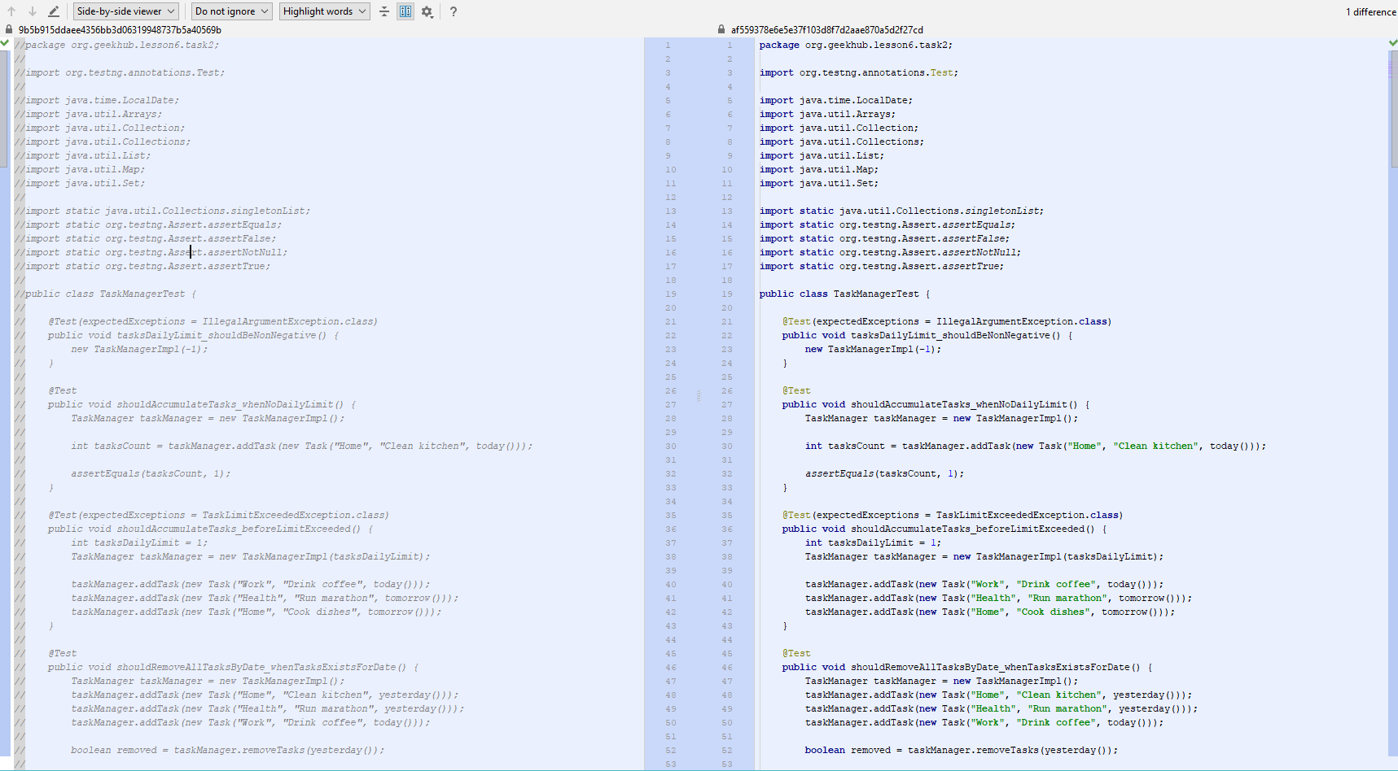
1. Use appropriate comment type - 1
Notes:
Do not modify unit tests. Even when you modify use appropriate comments type, to not trash the git history
Follow recommendations regarding previous home works feedback

Slide 3
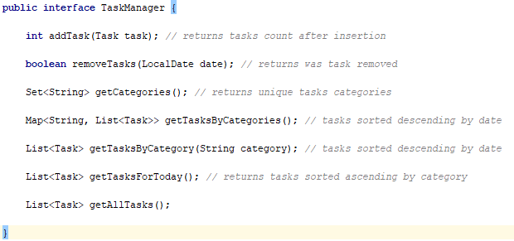
1. Use appropriate comment type - 2
Notes:
Use Java Doc

Slide 4
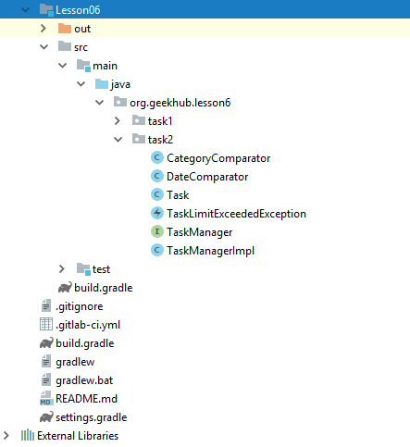
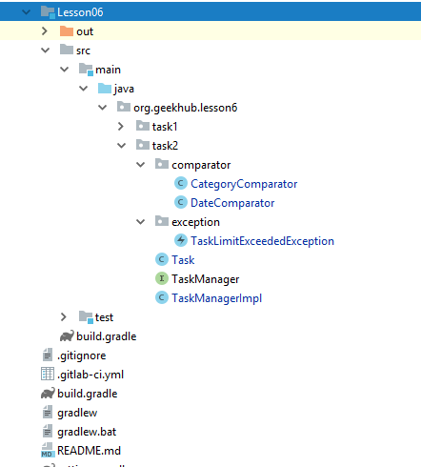
2. Use sub-packages for related classes

Slide 5
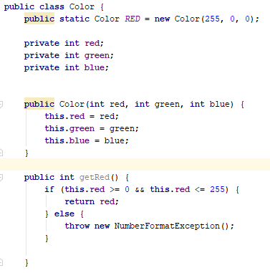
4. Use pre-validation but not post
Notes:
Color values should be validated during instantiation

Slide 6
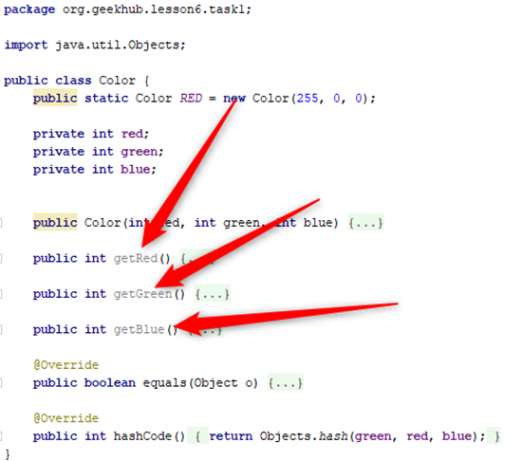
3. Do not write unused code

Slide 7
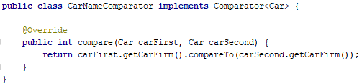
5. Use descriptive naming
Notes:
Comparator is expected to compare names but compares firms
In home task was to implement brand

Slide 8
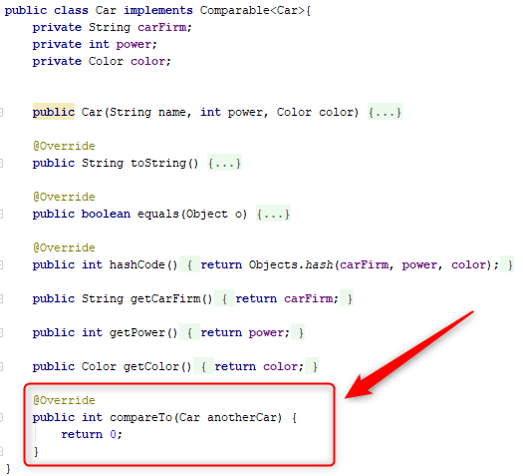
6. Do not write useless code
Notes:
Method should return different values

Slide 9
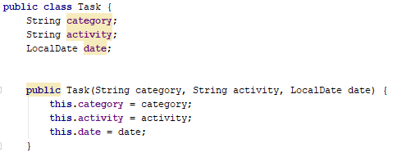
7. Use least needed access modifiers

Slide 10
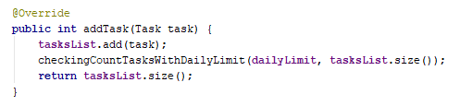
7. Do validation before action

Slide 11
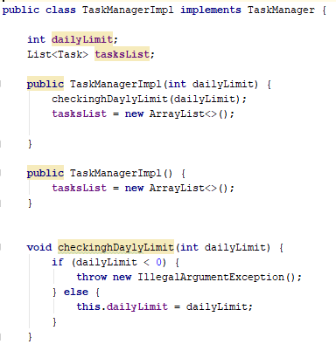
7. Do validation before action

Slide 12

8. Do not modify original data

Slide 13
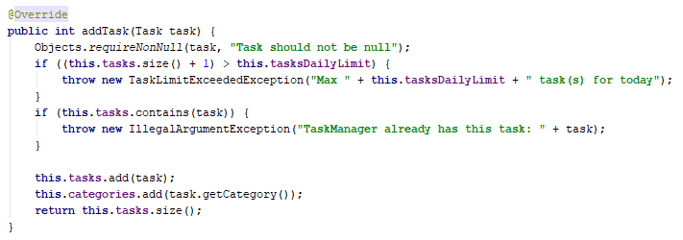
9. Keep it simple
Notes:
Just compare without current value without any calculations

Slide 14
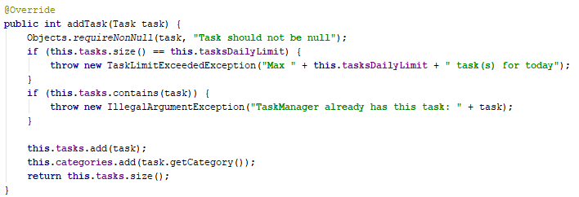
9. Keep it simple
Notes:
Do not use two stores which should be synchronized,

Slide 15
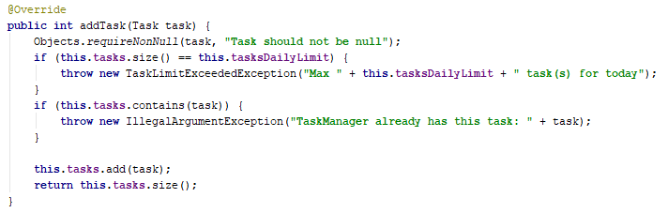
9. Keep it simple

Slide 16
10. Confuse in exception message
Notes:
Not for today but per day

Slide 17
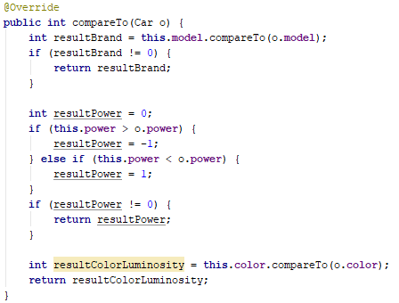
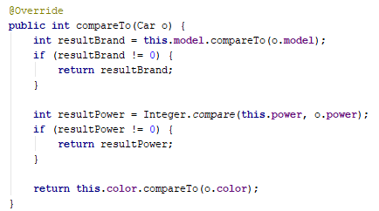
11 Keep it simple
Notes:
Use built-in code
Remove redundant var

Slide 18
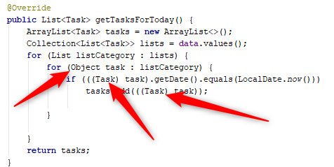
12. No class cast when generics is used

Slide 19
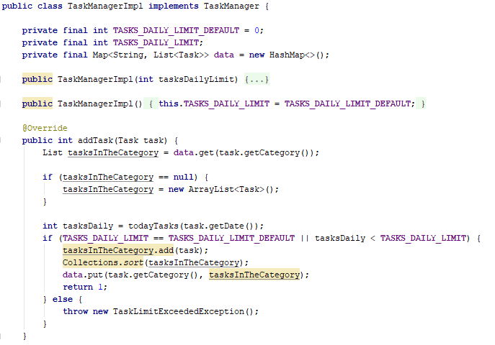
13. Use effective data structures

Slide 20
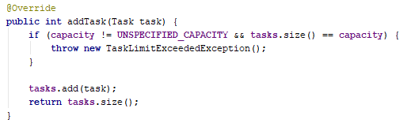
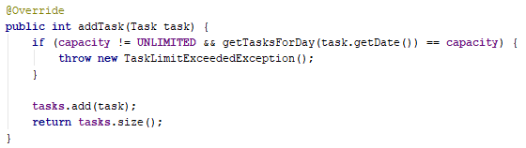
14. Incorrect daily limit validation

Slide 21
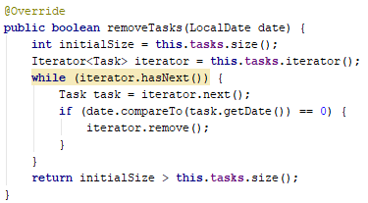
20. Use correct API
Notes:
Use equals for equality check

Slide 22
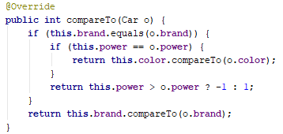
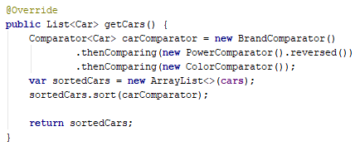
21. Clear is better than clever - 1
Notes:
Use equals for equality check

Slide 23
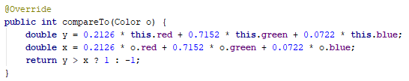
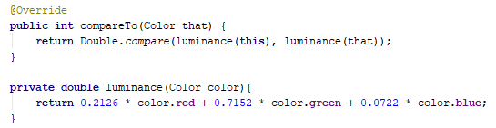
21. Clear is better than clever - 2
Notes:
Use equals for equality check

Slide 24
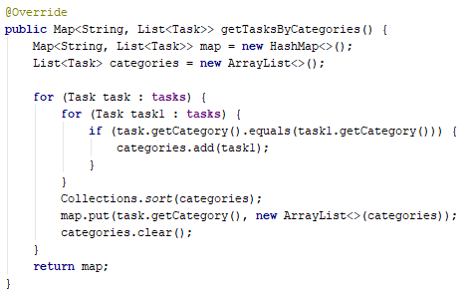
22. DRY - Do not Repeat Yourself, reuse code

Slide 25
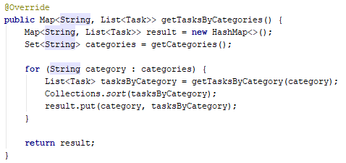
22. DRY - Do not Repeat Yourself, reuse code

Slide 26
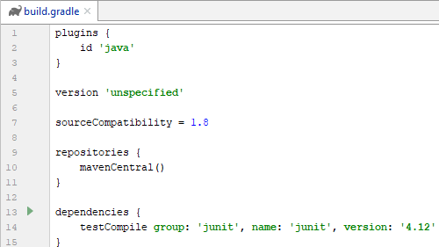
23. Trash

Slide 27
24. Better commit messages
L05-T3 Refactor and fix logic of VotingBox class
L05-T3 "fix methods“
L05-T3 #13 refactored voting box
L05-T1 #11 equals compared colors by values
L05-T2 add new check with null
L06-T2 Dell unnecessary lib from Task
Revert "L04-T1 Add checking for invalid symbol in the middle of String “
L05-T4 "many repetitions for accurate results“

